Slide 1

OP: HOUSE PRICES FORECASTING

Slide 2



PARTNER
INSTRUCTOR
TEAM MEMBER
Juha Vesanto – OP
Terhi Jävinen
Jorma Laaksonen
Roope Ruusuvuori
Anna Lebedeff
Mohamed Mkhaibou
Khoa Nguyen
Sami Valkamaa

Slide 3
Background: OP Bank
The largest housing loaner in Finland
House prices have an effect on:
Future profits
Risks
Solvency position
Predictions enable the organization to make budgetary and other business decision on house loans.

Slide 4
Task and Goals (1.5min)
Forecast house prices at least one year in the future (until end of 2021)
How the price behaves quarter-to-quarter
How the price behaves differently in each region
How the price behaves differently for each type of apartment
Visualize the result
Meaningful visualization of the future prices from different models
Obtain the forecasted result given region and house type.

Slide 5
Dataset
Source of data: Tilastokeskus
Data format
Three csv/txt files representing 3 apartment types: one, two and three-room flats
Each file consists of 80 rows of data representing the 80 regions in Finland
Each region has 58 columns representing data from 2006Q1 to 2020Q2
The regions are treated as a time series
Problems
All data sets have a lot of missing data
Reasons: no apartment sold in that period of time/ too few apartment sold (data masking)

Slide 6
Data pre-processing (4.5min)
Solution:
Removing regions with too many missing data
Regions with more than 70% of data missing were removed
Calling prediction of these regions would return: "This region does not have sufficient data for prediction“
Reason: Reduce the number of outliers Iterative Imputer can create.
Iterative Imputer (source: sklearn)
Multivariate imputer that estimates each feature from all the others.
A strategy for imputing missing values by modeling each feature with missing values as a function of other features in a round-robin fashion.
Removing outliers
The imputed data will be compared with the previous and next cell
If the difference between the imputed and the previous or next is higher than 450, the cell would be replaced with the mean of the previous and next cell
Reason: smoothen the time series for better prediction

Slide 7
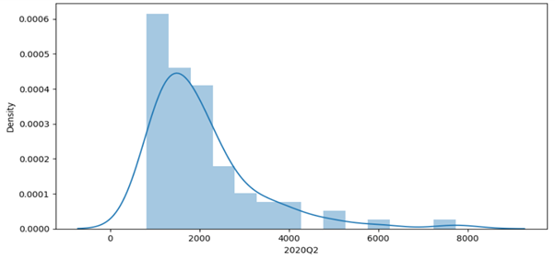
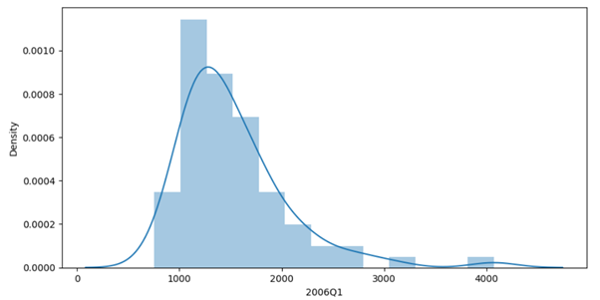
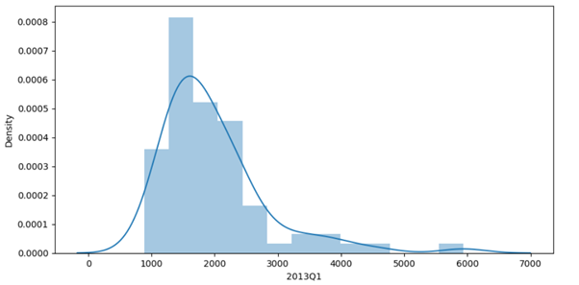
Exploratory Data Analysis

Slide 8
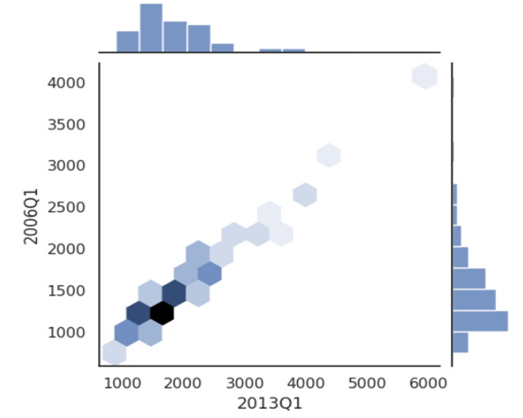
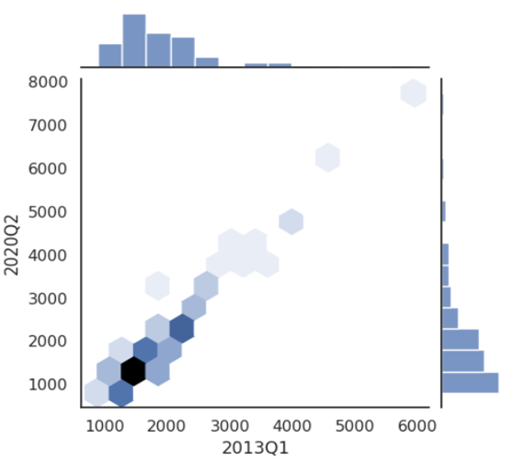
Exploratory Data Analysis

Slide 9
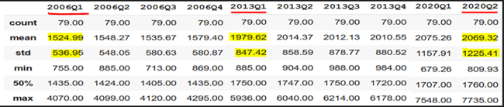
Exploratory Data Analysis

Slide 10
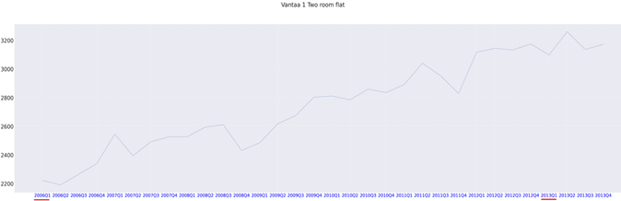
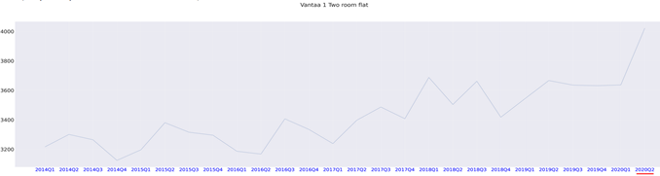
Exploratory Data Analysis (8.5min)

Slide 11
Modeling
Linear Regression
A simple model that compute the trend of the time series.
The trend is used to predict the house prices based on the years
Facebook Prophet
A powerful model for forecasting time series data with strong seasonality
Prophet is robust to missing data and shifts in the trend, and typically handles outliers well.
SARIMA
A seasonal autoregressive integrated moving average (SARIMA) model that explicitly supports univariate time series data with a seasonal component.

Slide 12
Enhancing credibility
Since each region is an individual time series that behaves differently, some functions are needed to enhance the quality of forecasting.
Linear Regression
The data is splitted into train set (2016Q1-2017Q4) and test set (2018Q1-2020Q2)
The start year that predicts closest to the test set is chosen as the optimal start year
Facebook Prophet
Predicts the future prices starting at different years
The one with the smallest error interval is chosen
SARIMA
Grid search for the best combination of parameters
Akaike information criterion, which estimates the prediction error, is minimized to find the best model

Slide 13
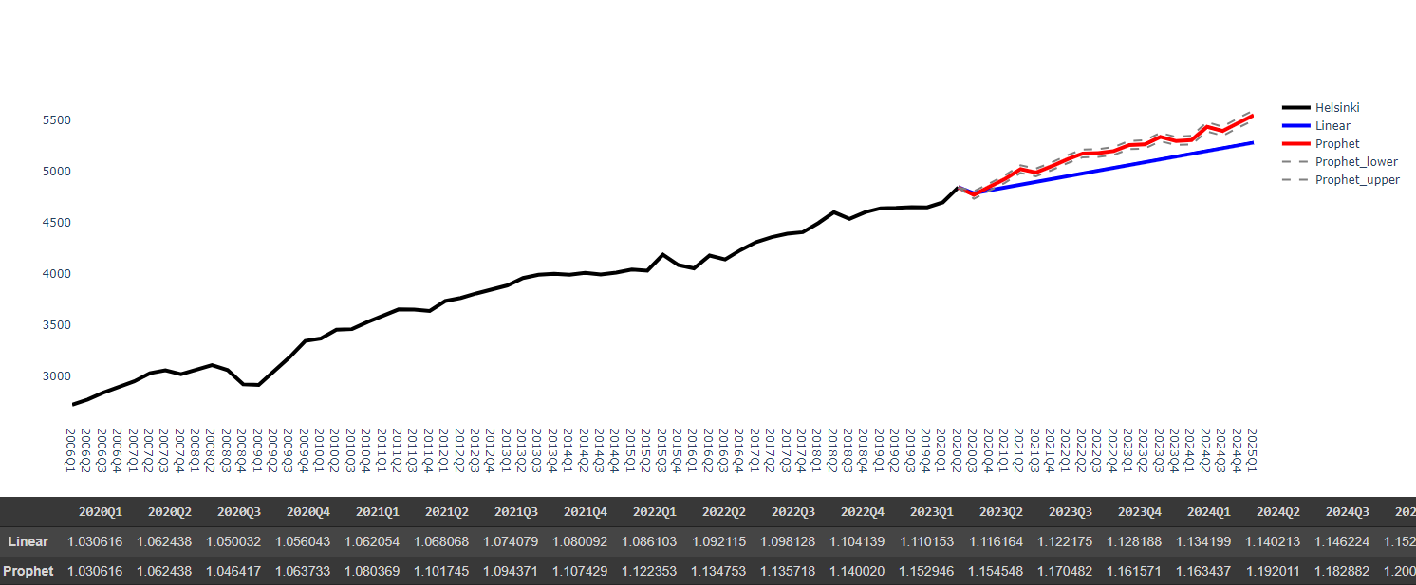
Results and Visualization
Linear Regression and Facebook Prophet
The function takes in the type of apartment and the region as parameter
Output is a plot and a table of the past and predicted price as index table with 2018 as pivot
Visualization of Two-room apartment in Helsinki Region

Slide 14
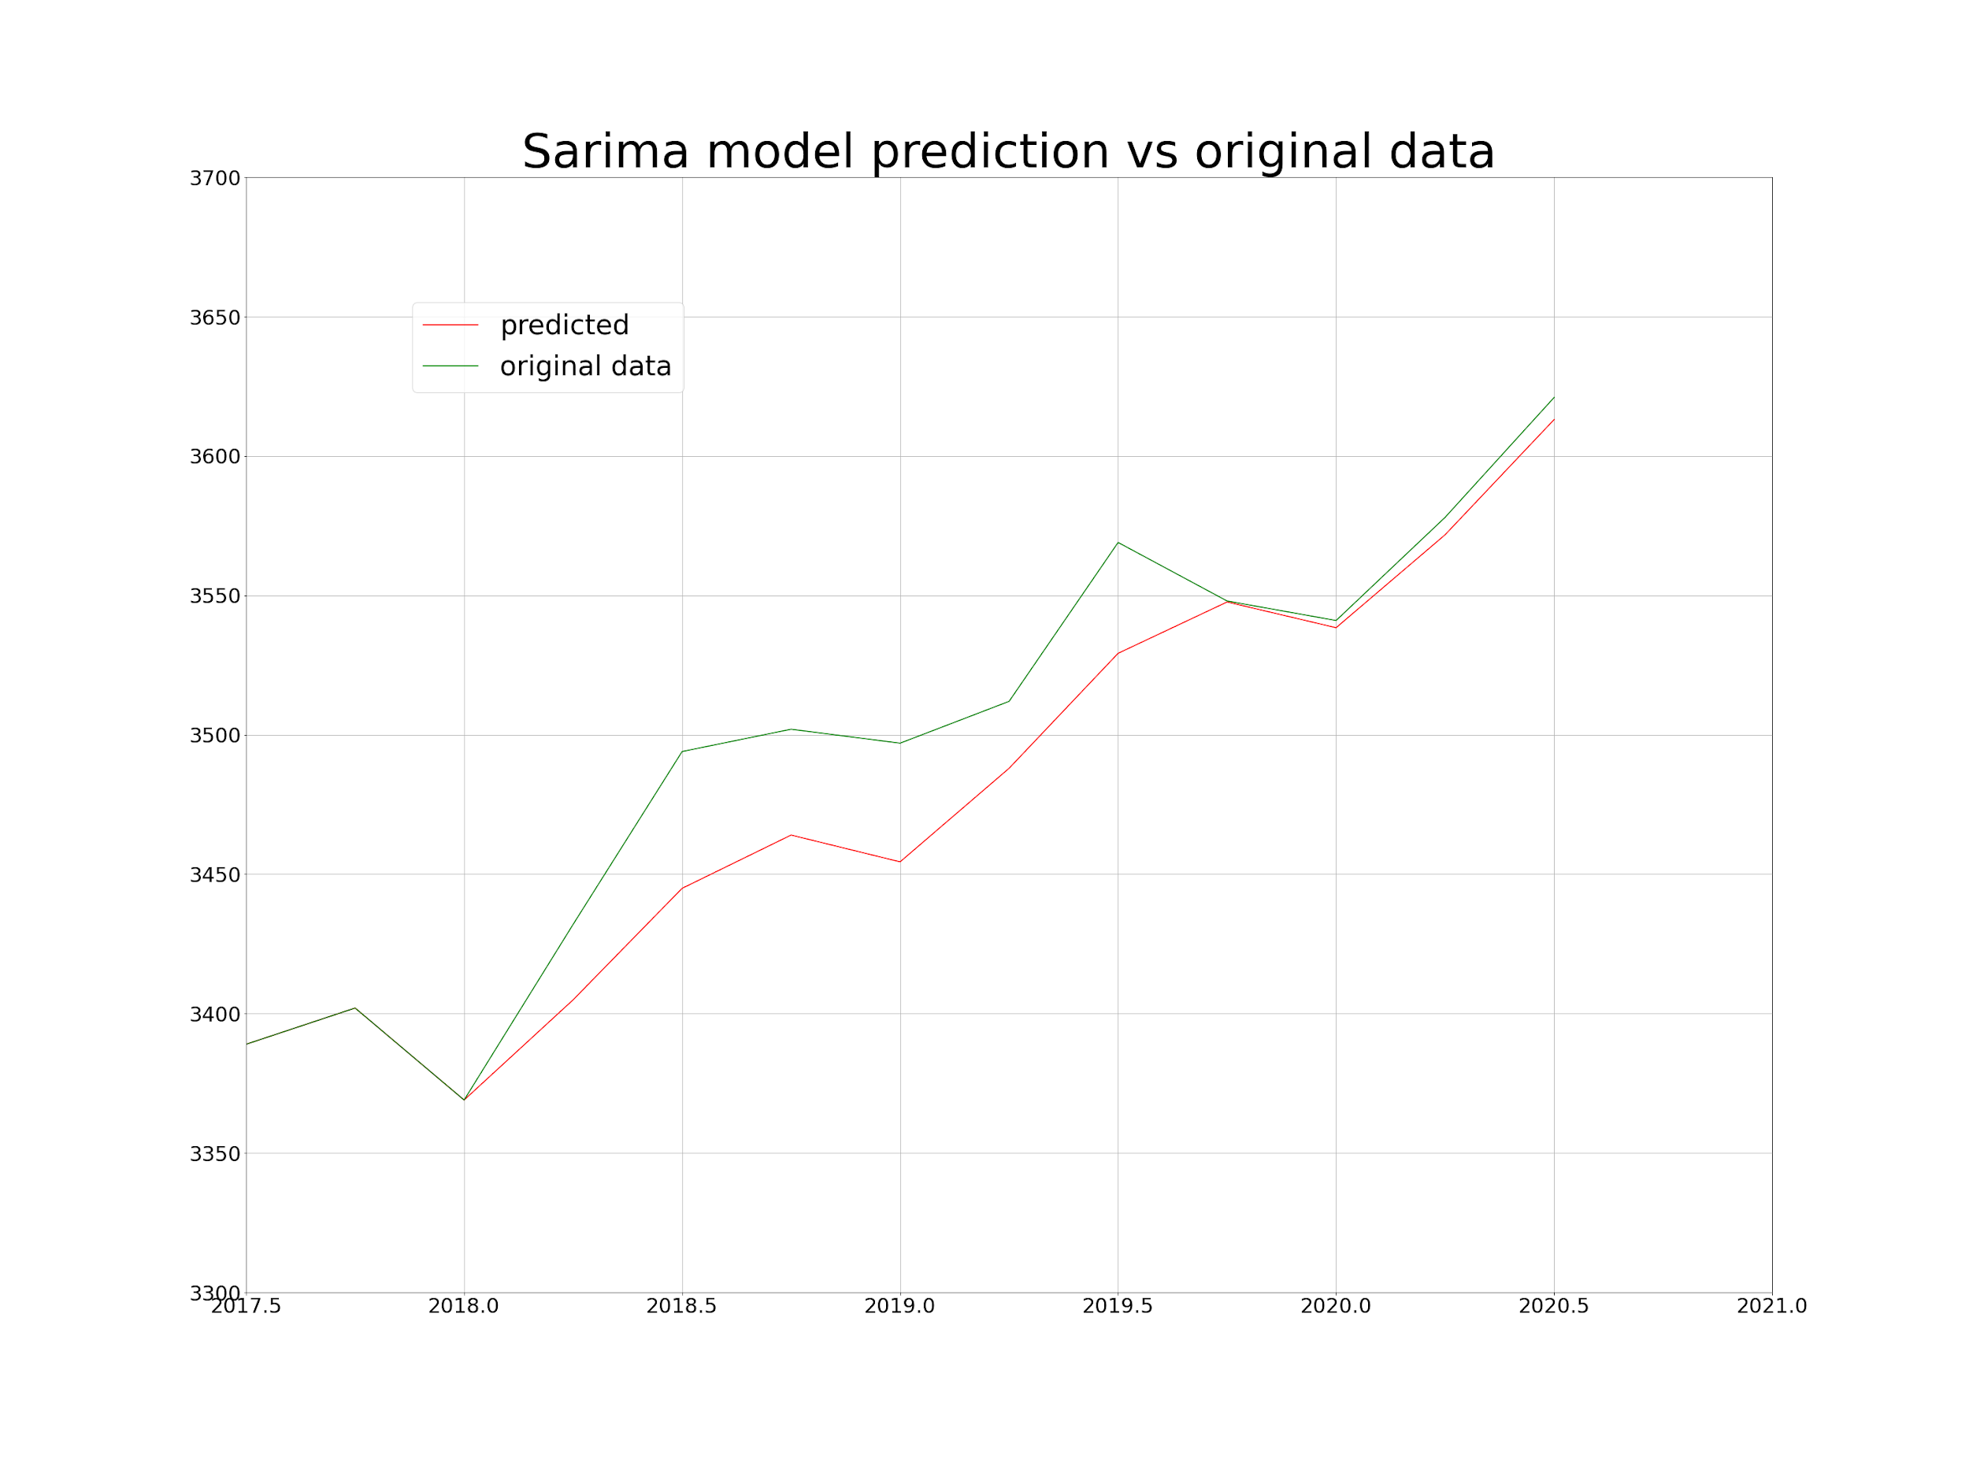
Results and Visualization
SARIMA
In training the sarima model achieved good accuracy with the model achieving a low mean absolute error and a low value of aic using data from 2016 onwards for the predictions, and thus was a good candidate model.

Slide 15
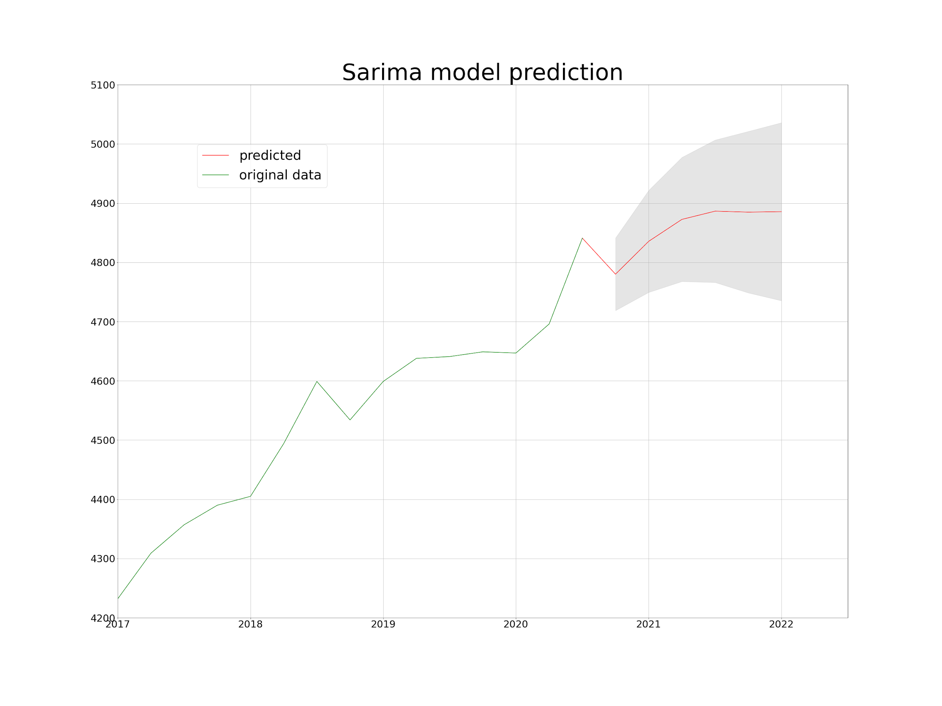
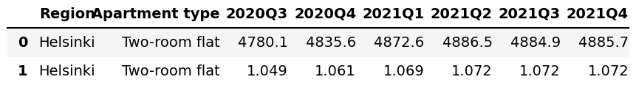
Result and Visualization
The prediction aic was minimized with using data also from 2016 onwards.
Shaded area shows the 95% confidence interval for the predicted values.
In the table, we can see the predicted values and the corresponding price indices wrt the average price of 2018.

Slide 16
Analysing results and models
Both prophet and sarima achieved good training accuracies with low mean absolute error.
Both models provide similar results, thus we assume them to be good. Also the sarima model gives a low aic value for the prediction which re-enforces this belief.
The sarima model is computationally more expensive as changing the region or the prediction interval needs the model to perform another grid search to find the best parameters for the new environment so if we do not possess enough computational power, the prophet model might be a better fit.

Slide 17
Tools and Libraries Used: (14min)
Pandas
DataFrame
Matplotlib
Seaborn
Plotly
NumPy
Datetime
Sklearn
Linear Regression
IterativeImputer
Facebook Prophet
Statsmodels
Sarimax
Adfuller
acf, pacf
pmdarima
auto_arima

Slide 18
Lessons Learned
Learned how to utilize the different Python libraries for Data Science.
How to work with a customer
How to divide tasks and work as a team.
The usefulness of Exploratory Data Analysis to find relevant information about datasets. Like discovering some bad imputations or knowing how our data is evolving.
Useful experience in data-preprocessing and implementing time series forecasting model, especially Prophet.

Slide 19
Conclusion and Future Prospects (16min)
Links to the results:
https://drive.google.com/drive/folders/1K9Ue3oSryTES8MSYCcl2ceZhtrnKwddM?usp=sharing
Future improvements:
Research possibly more sophisticated model options to predict the house prices.
Create an interactive visualization.
For example a map of Finland that presents the house prices for each region given a year and a quarter.
Study the accuracy of the model, when real data becomes available.
Implement some cross-validation to avoid overfitting

Slide 20
THANK YOU FOR LISTENING

